Slide 1

Fish Lasers: A Theoretical Project
Benjamin Bish

Slide 2
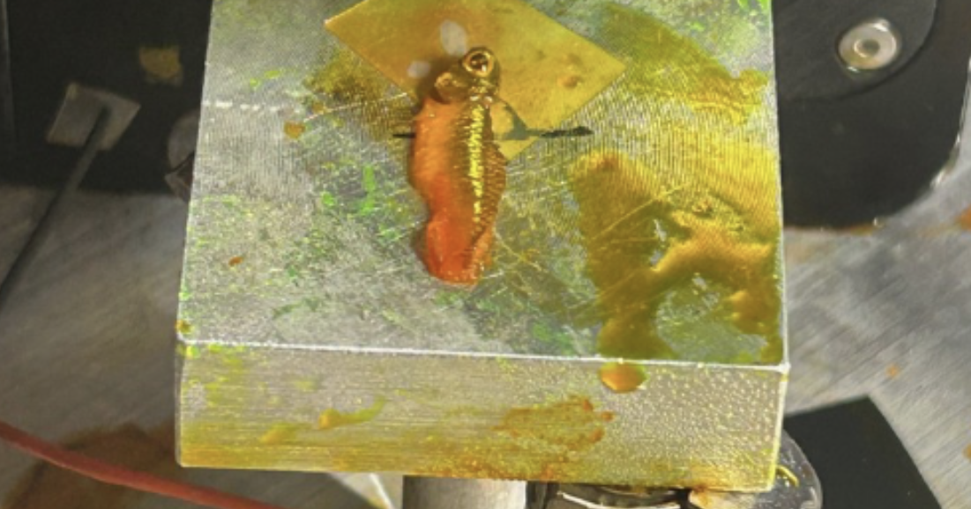

Slide 3
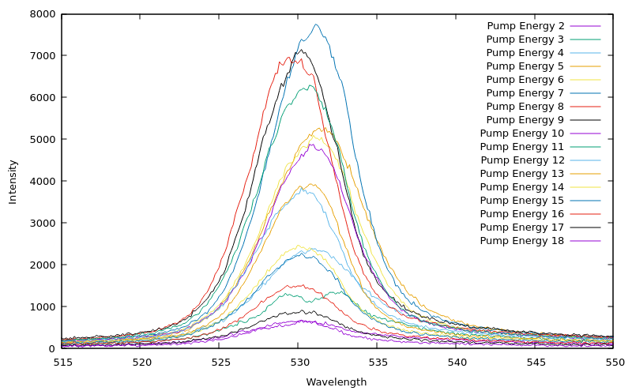
Fit Emission Spectrum

Slide 4
Iridophore Code Process
Input
Output Wavefront
Plate Angle
Polarization
Compute Complex Physical Map
Compute Spectral Map in k Space
Notes:
Real Phase map(plate orientation). Complex gain map(dye in cells)

Slide 5
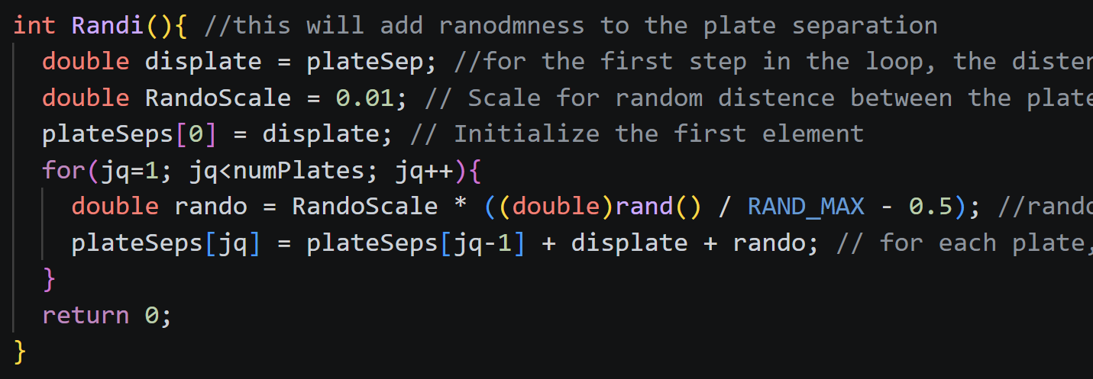
Implemented Randomness

Slide 6
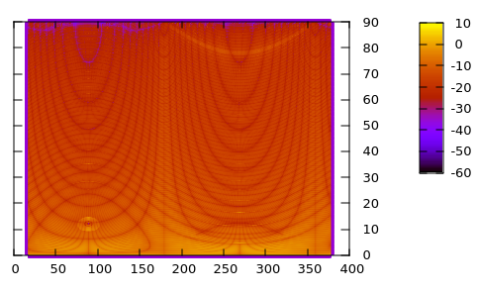
Cartesian To Polar

Slide 7
Highlights
Applied topics learning in Quantum Mechanics and Mathematical Physics
Expanded my knowledge of complex topics

Slide 8
Challenges
New to Linux and coding in C
Cleaning Code and finding issues

Slide 9
How my academics prepared me
Coding Techniques in Math Methods
Perturbation Methods in Quantum Mechanics

Slide 10
My Takeaways from research
Experienced real physics research
Learned this is my passion, and want to pursue research

Slide 11
Thank You!

