Slide 1
Crowd Dynamics Modeling
By Jeremy Moore

Slide 2
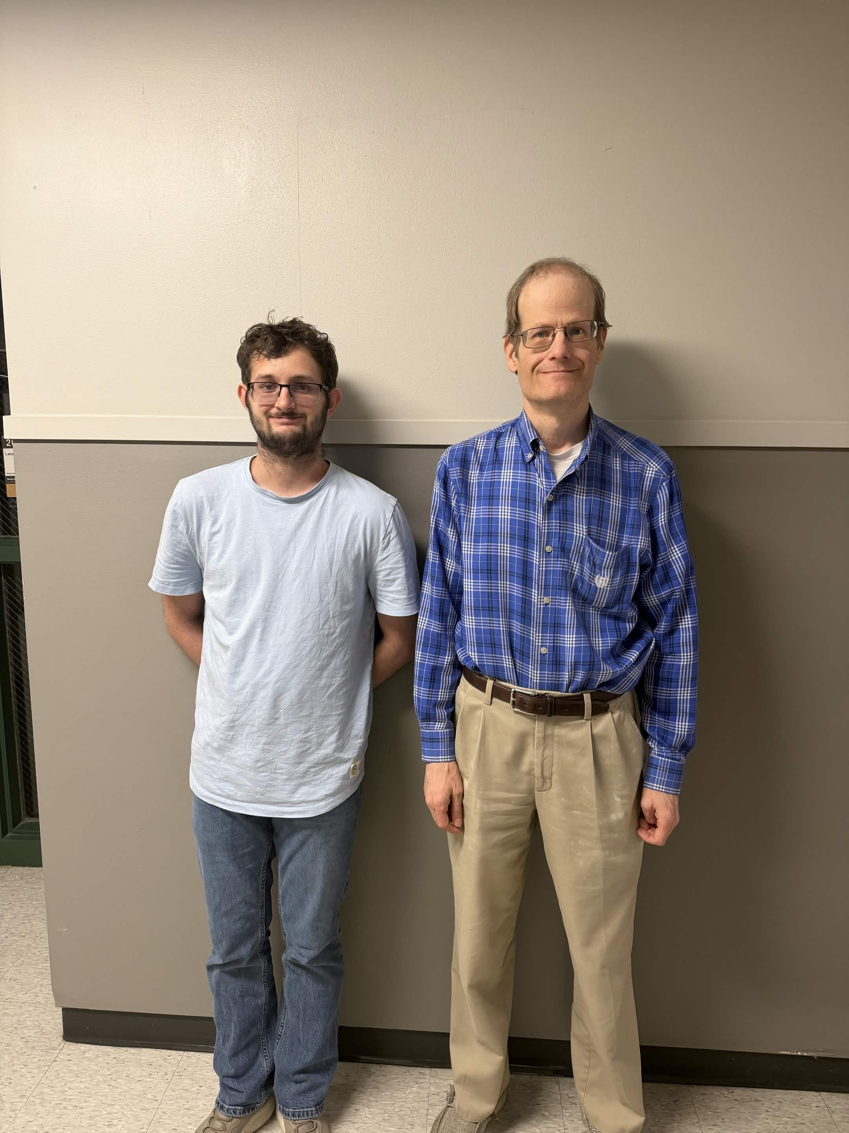
Introduction
How does a crowd affect a person's ability to leave a room?
This was a question posed to me by my mentor Dr. Priour, who suggested I explore crowd dynamics simulation.
Thus, I began to investigate two primary inquiries, what numerical impact a crowd has on a localized individual, and whether that numerical impact is linear or exponential in nature.

Slide 3
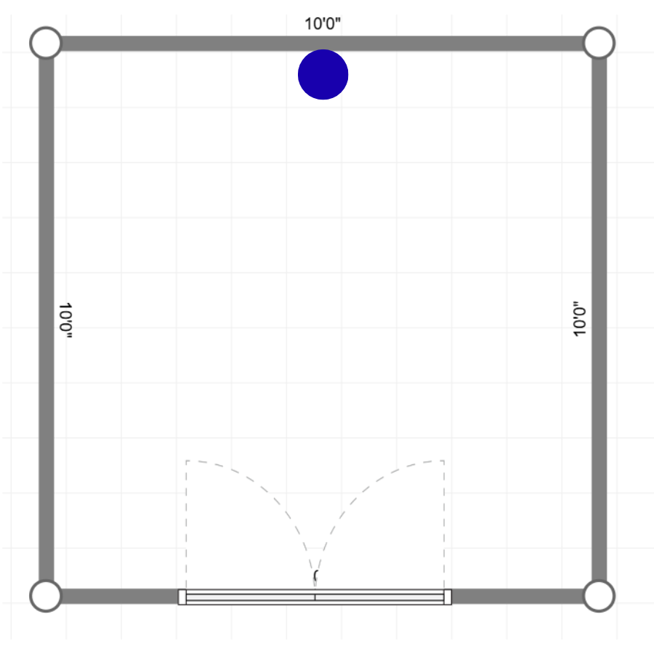
Methodology, Prototypes
Developing the crowd dynamic model has required the development of six total prototypes that iterated and expanded on specific aims.
In each prototype several starting conditions remained fixed.
Each crowd member was held within a 10 by 10 meter room, with a 5 meter exit.
Each crowd member also had a set standardized velocity magnitude of 1 m/s, with a radius of .5 m.

Slide 4
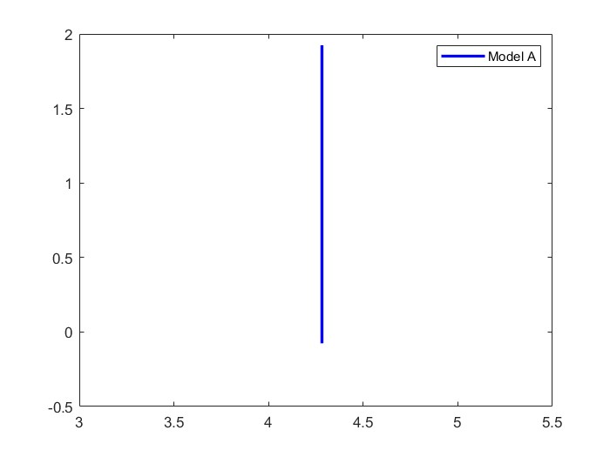
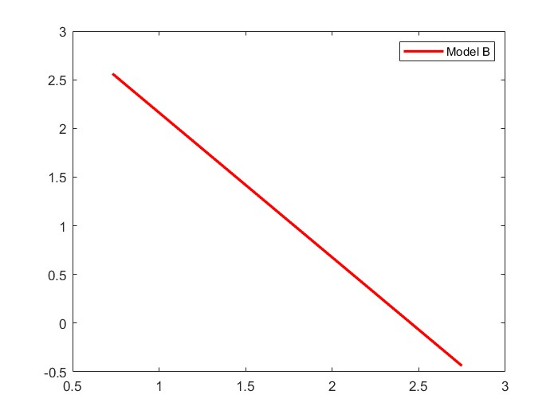
Prototype, Model A and B
The first two prototypes involved developing the initial starting conditions for the simulation and programming the basic behavior of the two distinct types of crowd participants in A and B.
Type A, beelines in a straight path towards the exit, and stop to avoid a collision.
Type B, meanwhile, moves in a random path, and only changes course to avoid a collision.

Slide 5
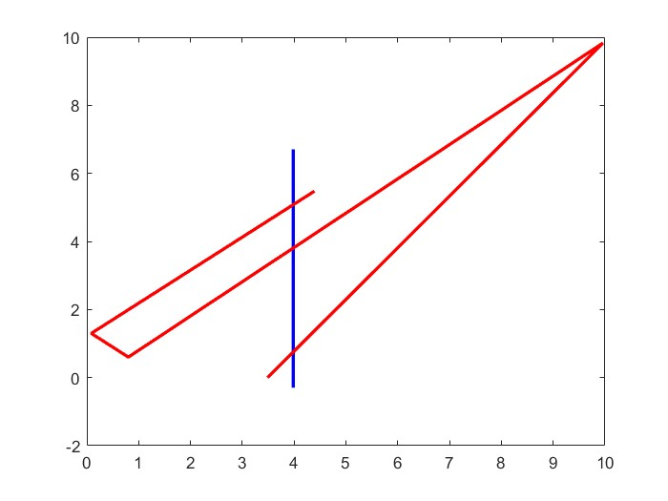
Methodology, Model 3
Prototype 3 involved fusing models 1 and 2 together.
This led to a model in which A and B members would coexist and interact, with B serving as moving obstacles to slow down A.

Slide 6
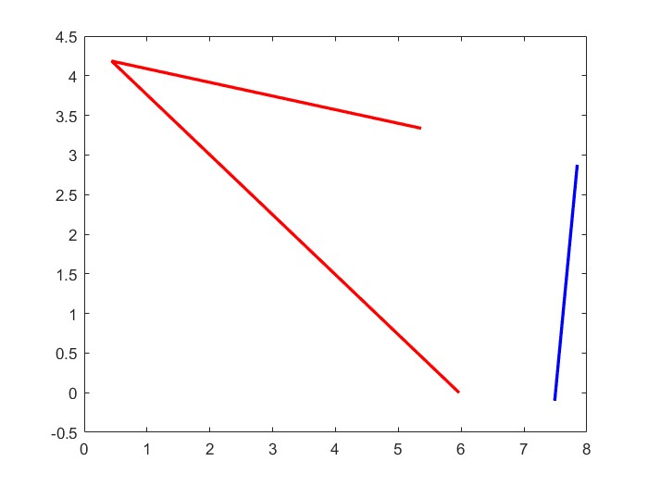
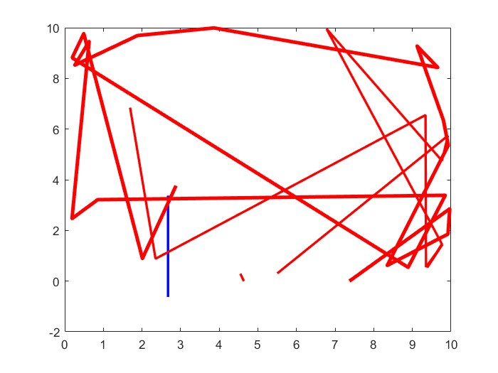
Prototype, Model 4
In this model crowd assignment shifted from an individual variable approach to a table approach, allowing for the crowd size to be modular with each run.
Geometric interference were also programmed into this model, with each member getting a boundary box, which is a region depicting the region of space they fill up.

Slide 7
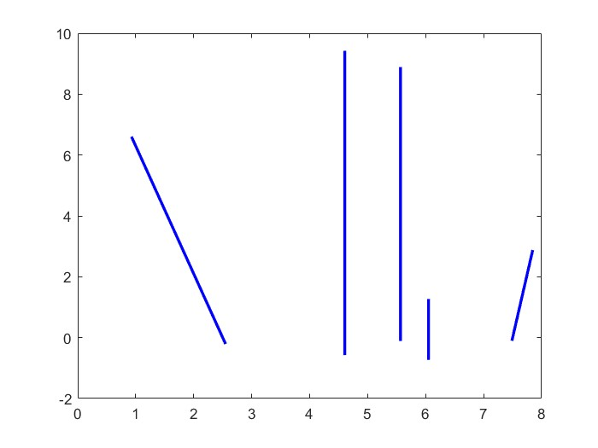
Prototype, Model 5
Prototype 5 involved a shift in project scope.
Instead of running a single run like the earlier iterations, model 5 was designed to run multiple simulations at once to obtain a statistical average of data over multiple runs.
However, due to the storage module storing all position data, this approach was limited to how many runs Matlab could run at a time.

Slide 8
Prototype, Model 6
Prototype 6 worked to fix the maximum simulation issue present in 5, by simplifying the data storage to only record the time of escape of A.
The program was also reworked to run multiple series of runs at different crowd sizes to derive the impact type B has upon type A.

Slide 9
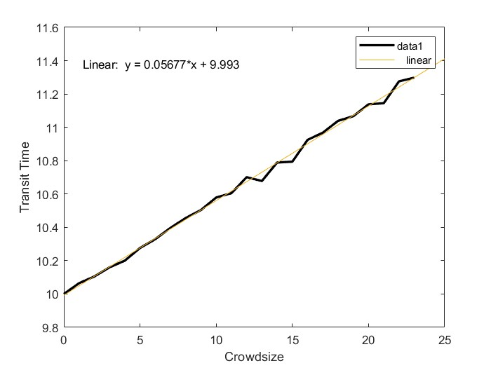
Data
The X component represents the size of the crowd, the Y component represents the average of 1000 total runs at that crowd size.
The impact of crowd interference increases the time it takes for A to leave by .05677 +/- 0.0002677 seconds with a standard deviation of 0.0005986 for each crowd B member added to the simulation.

Slide 10

Conclusions
Based upon the earlier data, a linear comparison can be drawn between crowd size and transit time.
This falls in line with the diffusion behavior expected for this type of model, in which distance is proportional to the rate times a constant times time.

Slide 11
Goals for the Future
The primary goal for the future is to expand upon the model by incorporating more dynamic crowd dynamic modeling.
The goal would be to shift from a low interaction model, to one that can simulate basic moment and pushing behaviors.
Due to the complexity of the task though, I have not had the time or ability to implement it’s full scope, because of the many edge cases present in such an approach.

Slide 12
Why This is Important
This research served primarily as a learning experience.
Through it I developed a strong understanding of the strengths and limitations of matlab as a simulation software.
In addition to this I have obtained valuable insight into the considerations that need to be made when developing a modeling software, which in the future will lead to more refined models.

