Slide 1
Laser for Rubidium Quadrupole Transition
Joseph Gorkos

Slide 2
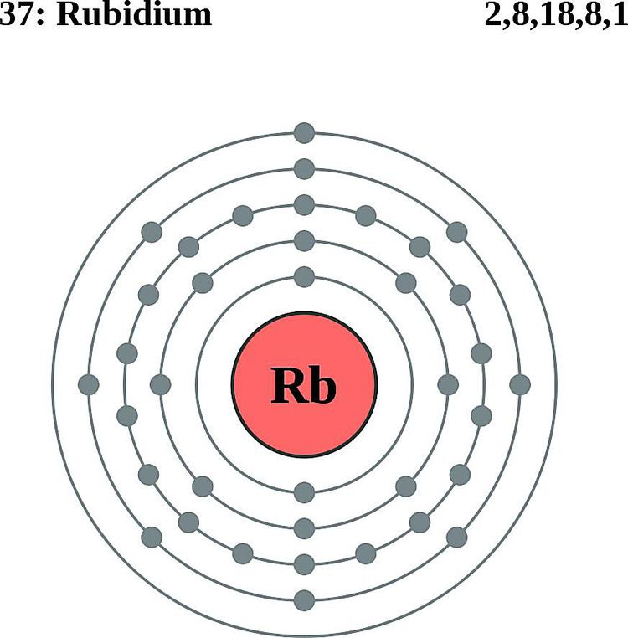
Theory
Rubidium is widely used in high-precision atomic clocks and studies in quantum optics. Besides its availability in a laboratory setting, dipole forbidden transitions in Rubidium are very narrow, thus good for precision measurements.
Light interacts with atoms by acting like an oscillating electric field, “pulling” the electron back and forth, like shaking a tiny charged object.

Slide 3
Experiment
In a Dipole-Allowed Transition, the electron’s initial and final states are arranged conveniently. The atom can easily develop a separation of charge. These transitions are strong and quick, shown by bright spectral lines.
In a Dipole-Forbidden Transition, the electron’s initial and final states are arranged in a way that the shaking cancels itself out. This transition is weak or doesn’t happen at first order.
Our experiment is to study this phenomenon using a laser diode and control circuit. Our goal, however, is to build the laser-circuit system.

Slide 4
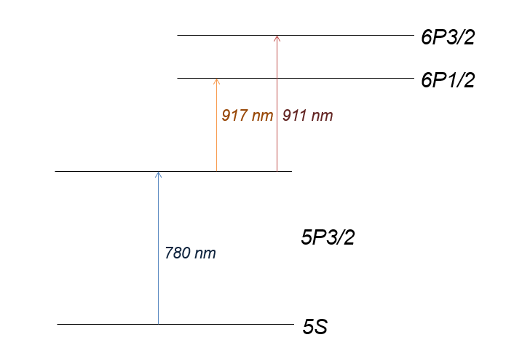
We use a 780nm laser to excite atoms from the 5S state to the 5P3/2 state.
While a 776nm laser is typically used to reach the 5D state, we instead probe transitions to the 6P1/2 and 6P3/2 states. These can be accessed using lasers at approximately 917nm and 911nm, respectively.
The 5P3/2 to 6P transitions are dipole-forbidden and occur through higher order processes like electric quadrupole coupling.
5P3/2

Slide 5
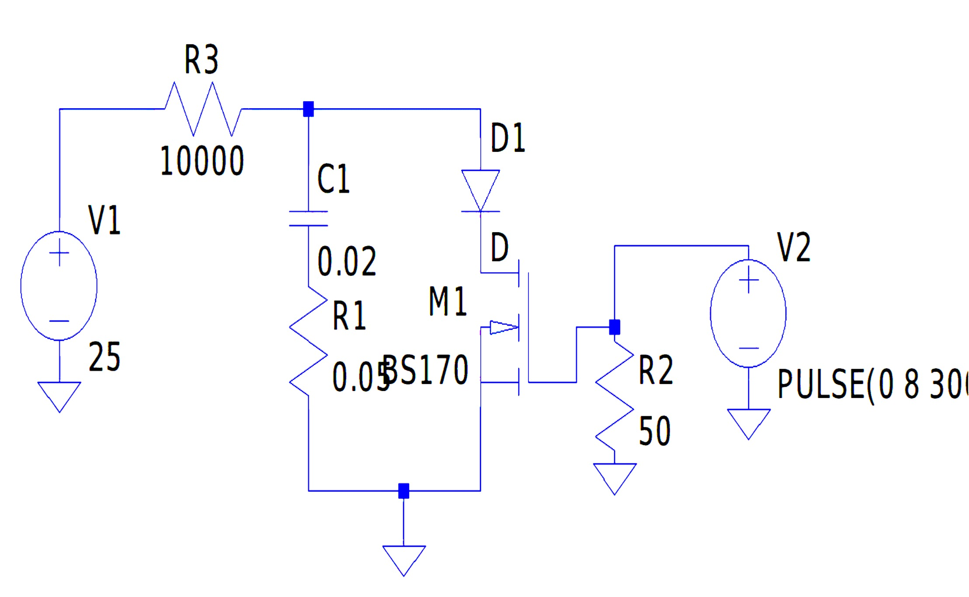

Diode

Slide 6
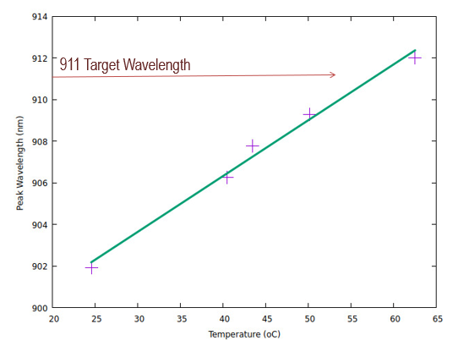
Thermal Tuning
To ensure our laser diode could reach the target wavelength of 911nm, it needed to be tunable while connected to the control circuit. The temperature of the diode could be adjusted in a temperature-controlled casing.
We documented the linear effect of temperature on the wavelength. Using this we ascertained that we could reach the target wavelength for the atomic excitation.

Slide 7
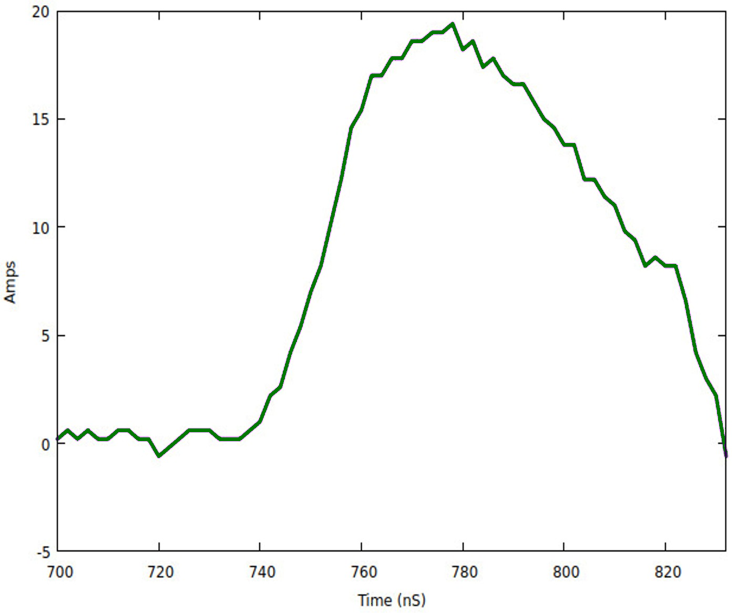
Data
With the circuit and diode assembled and connected, we proceeded to test the combined system. We measured the laser diode current during a pulse to confirm the system was functioning properly.

Slide 8
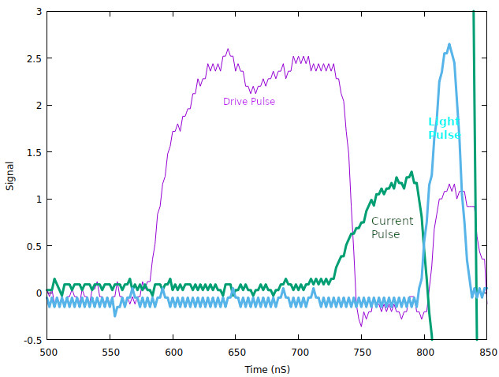
Data
We collected also the light output pulse on a high-speed photodetector. That (in cyan) together with the drive pulse (in purple) are shown.

Slide 9
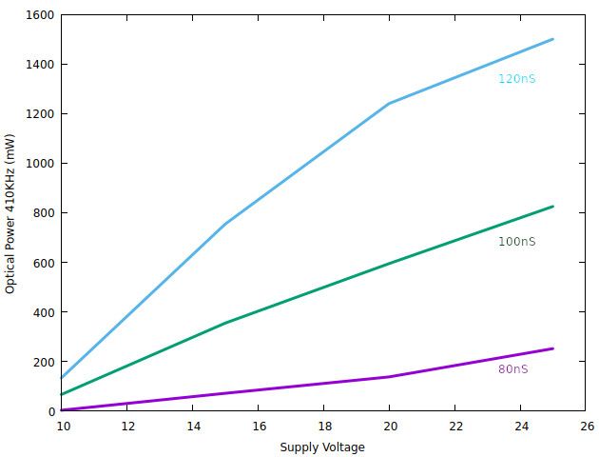
Data
We experimented with different pulse times to see how the total averaged output power of the laser diode varied. In the graph below we changed the circuit drive voltage for three different pulse times.

Slide 10
Conclusions
Our laser diode is tunable with temperature and can stably produce light at the target wavelength of 911nm. Our circuit successfully controls the laser diode, enabling us to reach the quadrupole-allowed transition in atomic Rubidium. With these two accomplishments, the circuit-diode system may be used in future experiments.

