Slide 1
Two-Photon Transition in Rubidium
Raymond Miller
Youngstown State University

Slide 2
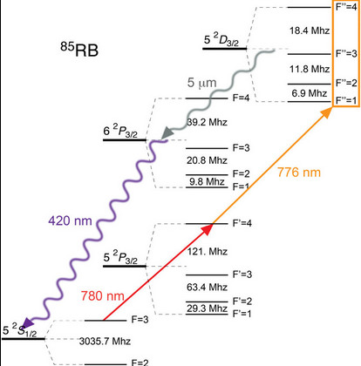

Slide 3
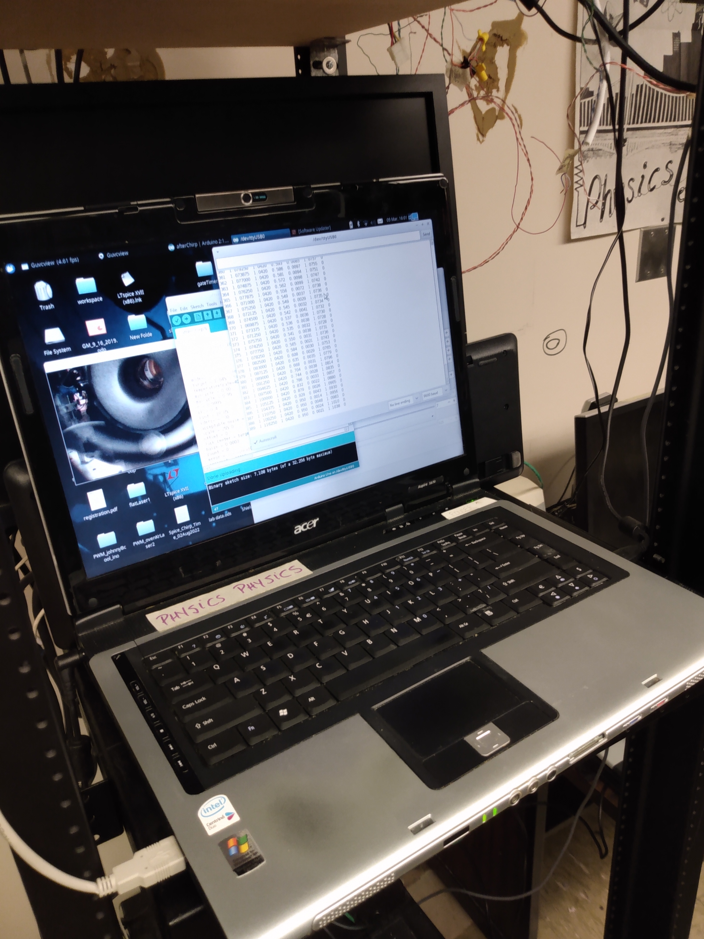
PID control of 776nm
Laser (cooling loop)
IR camera to verify
780nm pump is on
resonance

Slide 4
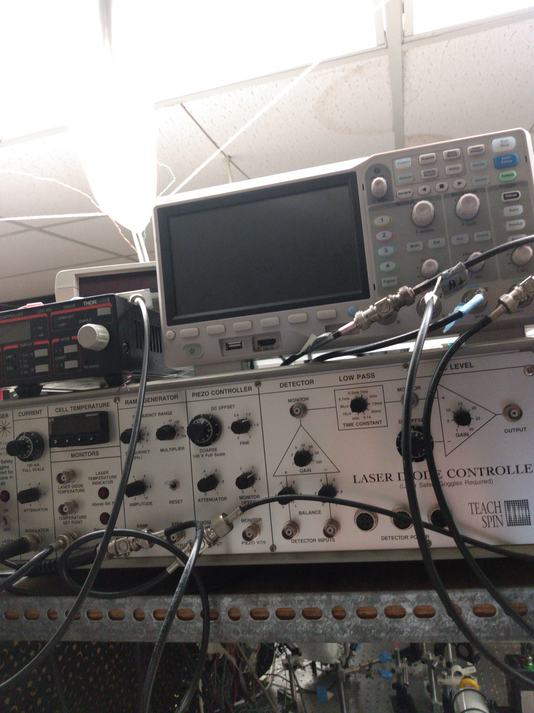
Oscope for data
collection
776nm laser
current controller
780nm laser
controller
(temp/current)

Slide 5
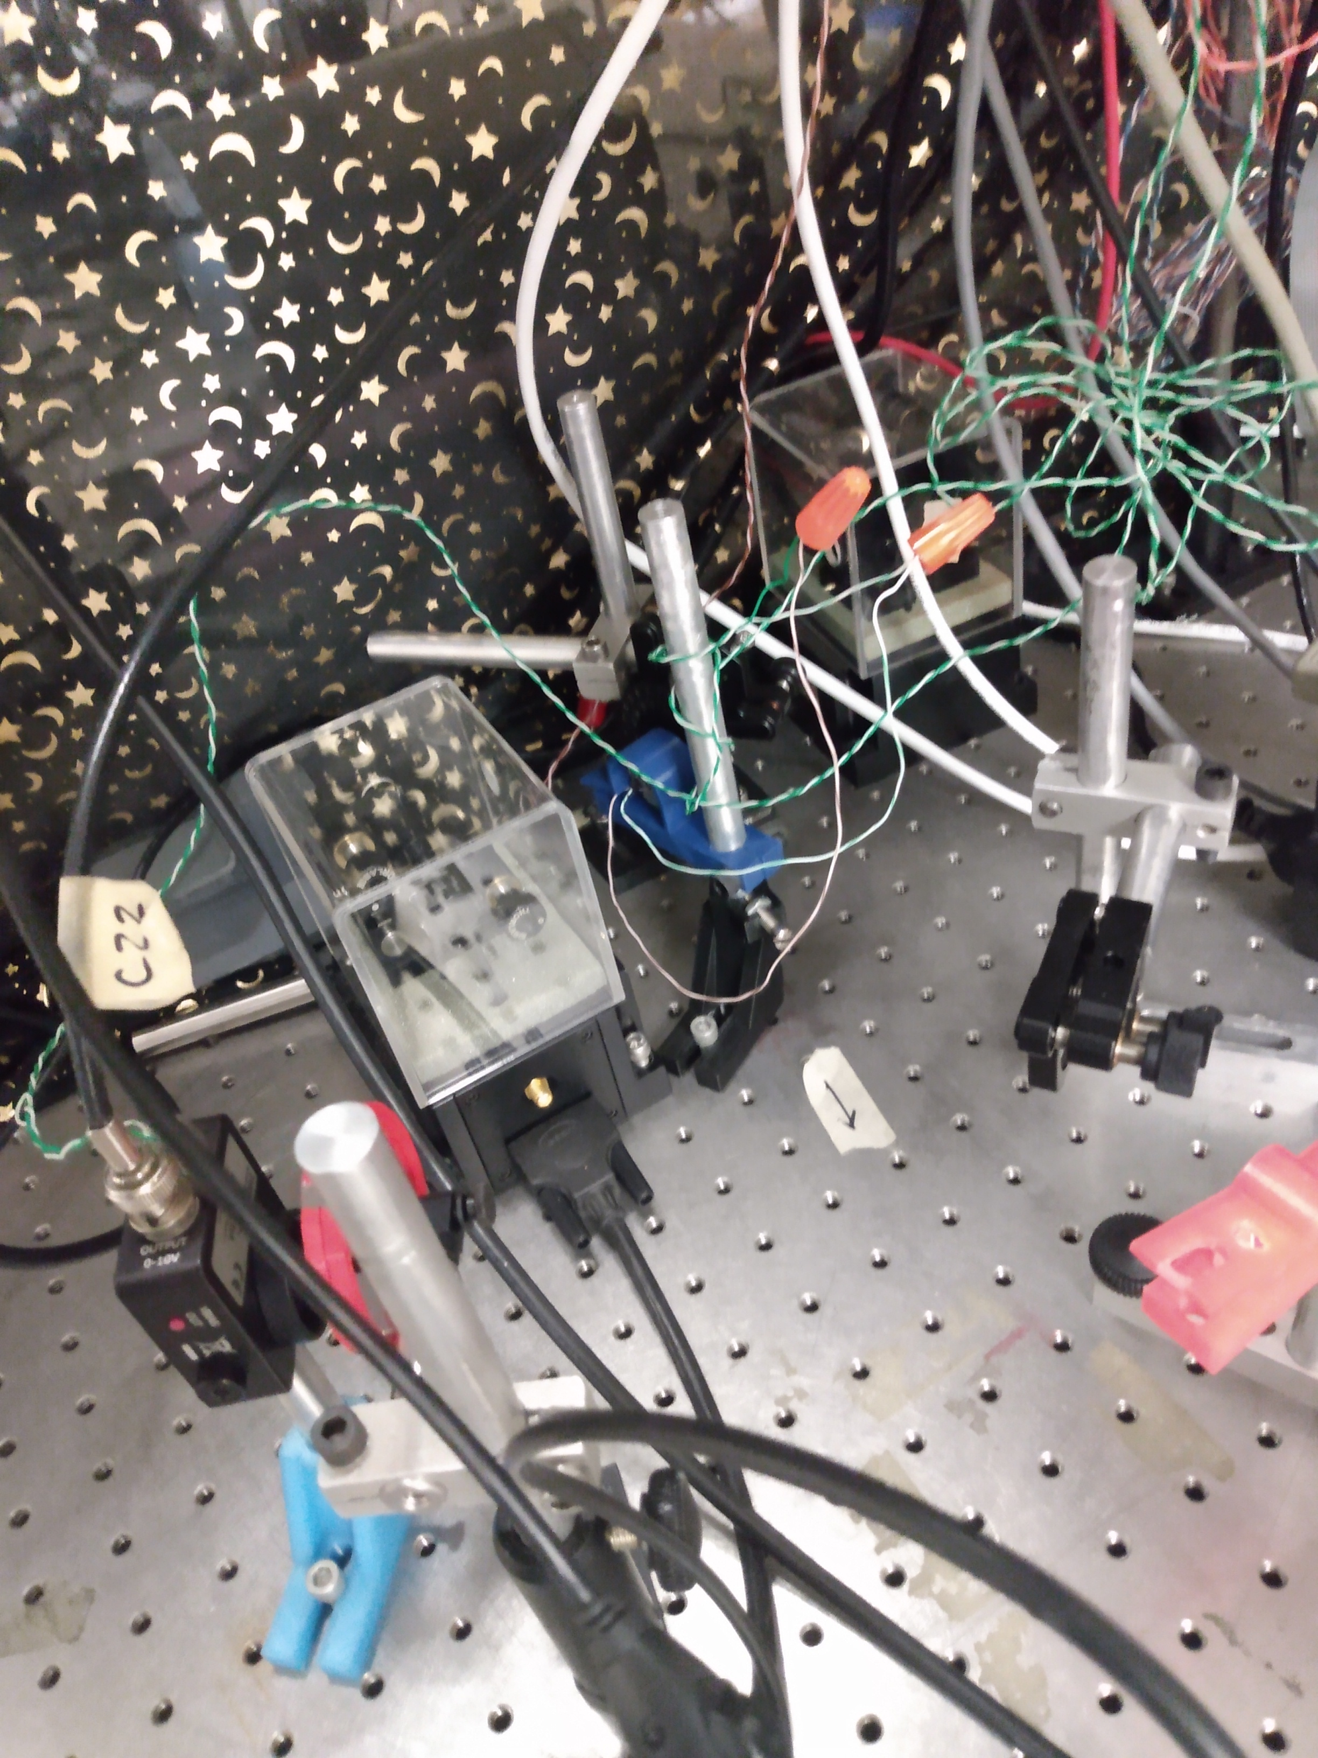
780nm laser
Chopper
Reference
Signal generation PD

Slide 6
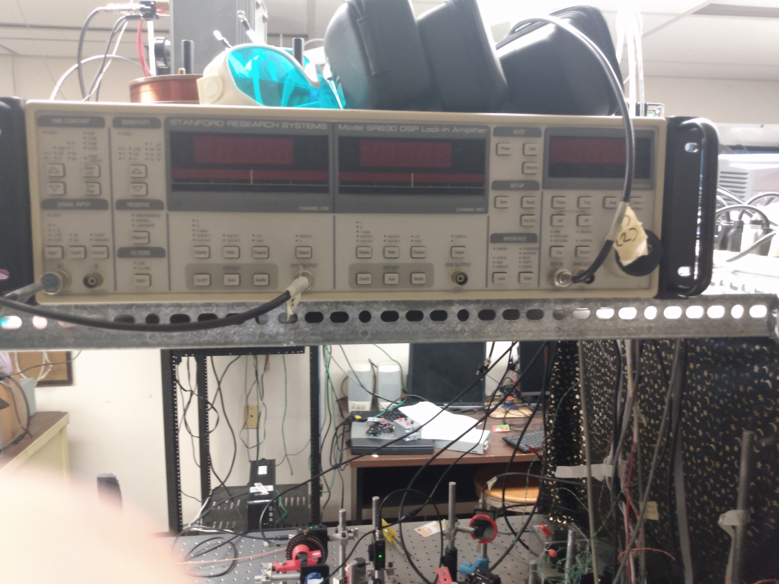
Lockin
Amplifier

Slide 7
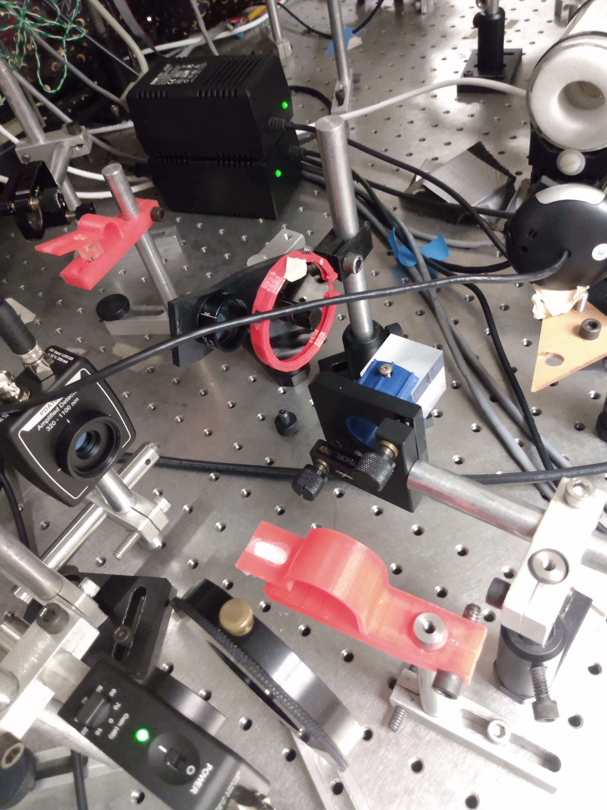
Rb cell/cell heater
Polarization clean up
camera
Variable attenuator
Polarizing beam cube
776nm transmission
PD sensor

Slide 8
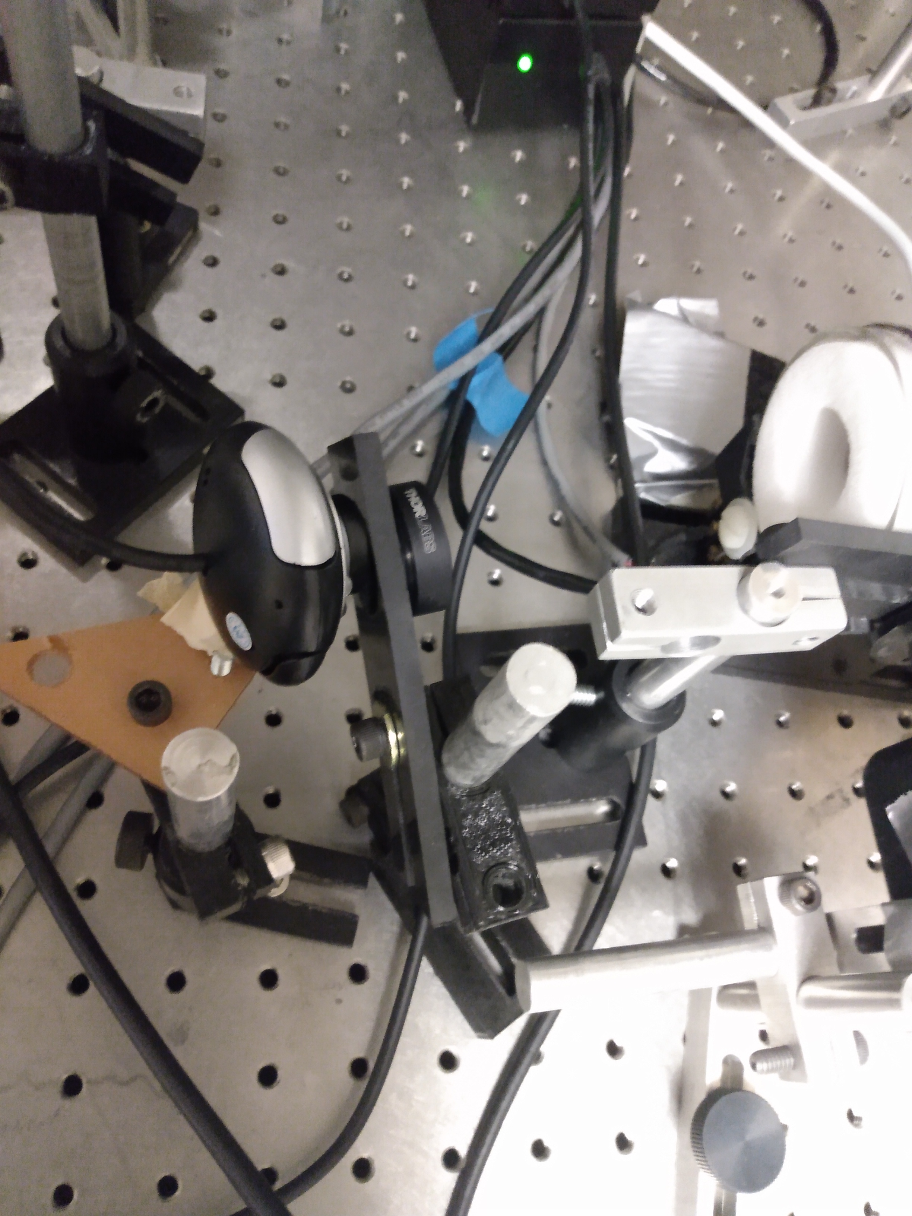
ND Filter
Rb cell / cell heater
IR camera

Slide 9
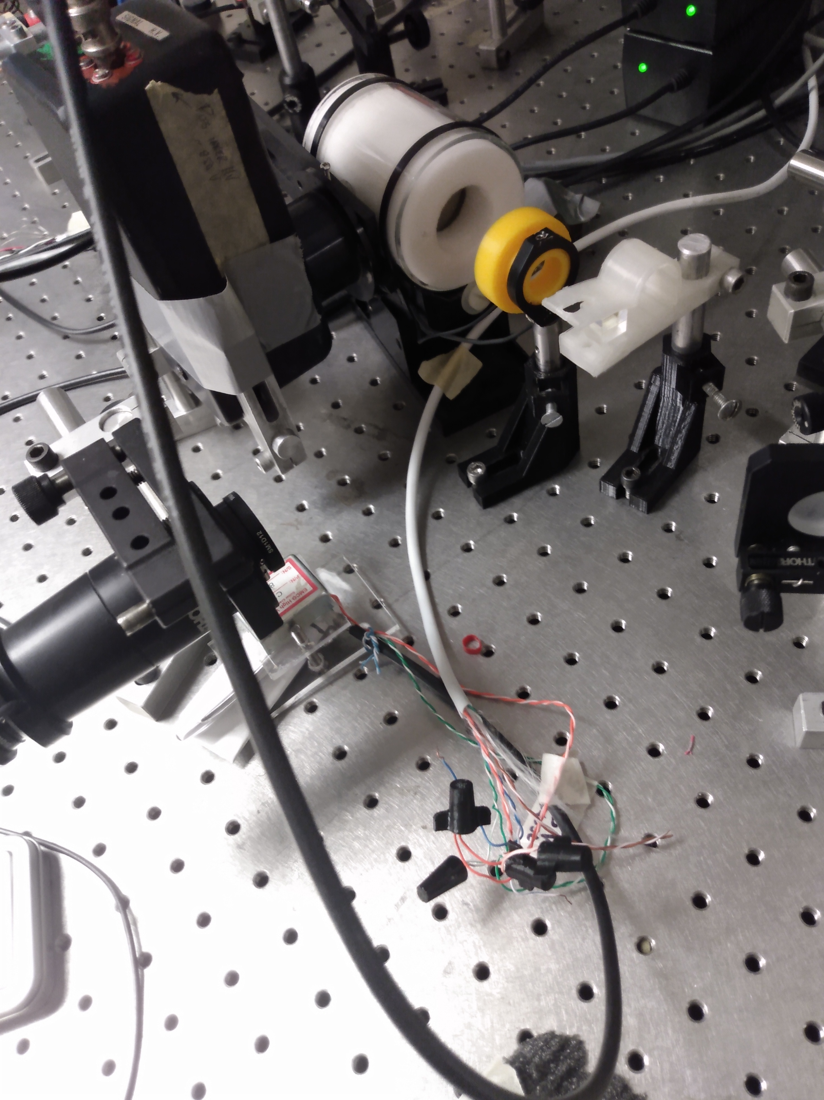
From the other side
PMT HV supply
waveplate
PMT
Polarizing beam cube
Fabry-Perot cavity

Slide 10
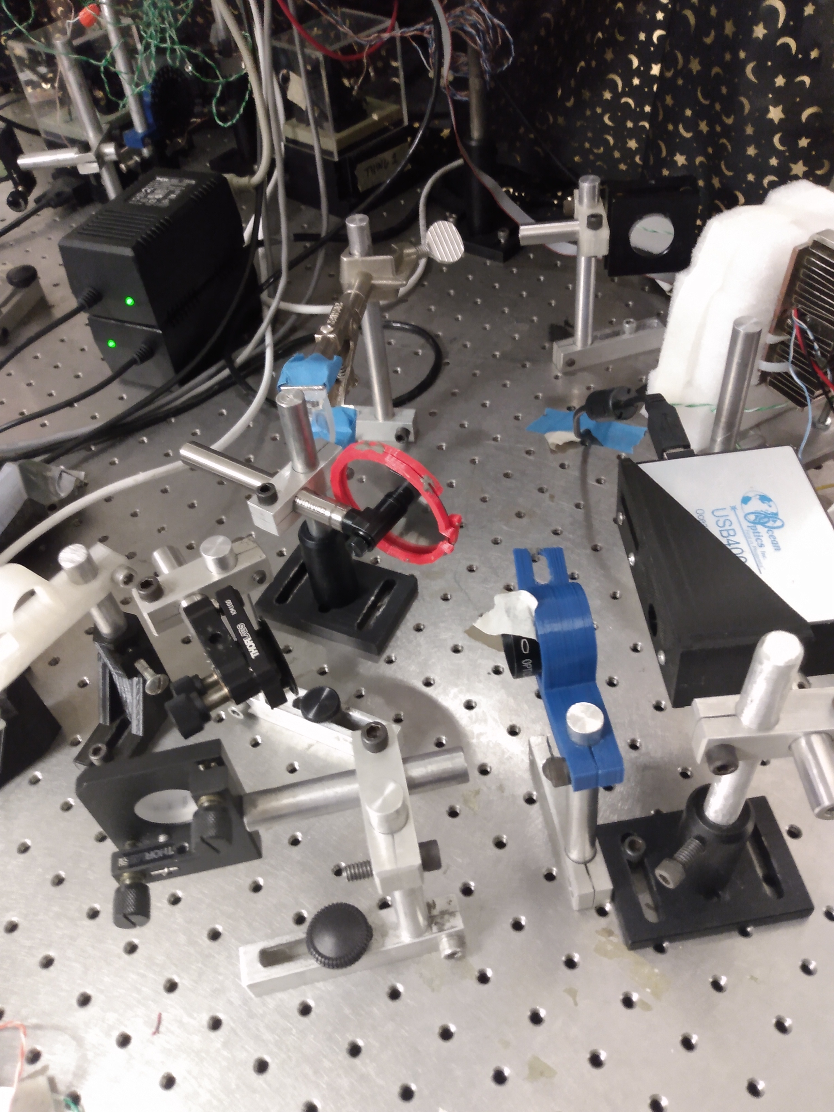
776nm laser
Variable attenuator
Low resolution
spectrometer
Pickoff pellicle
ND filter

Slide 11
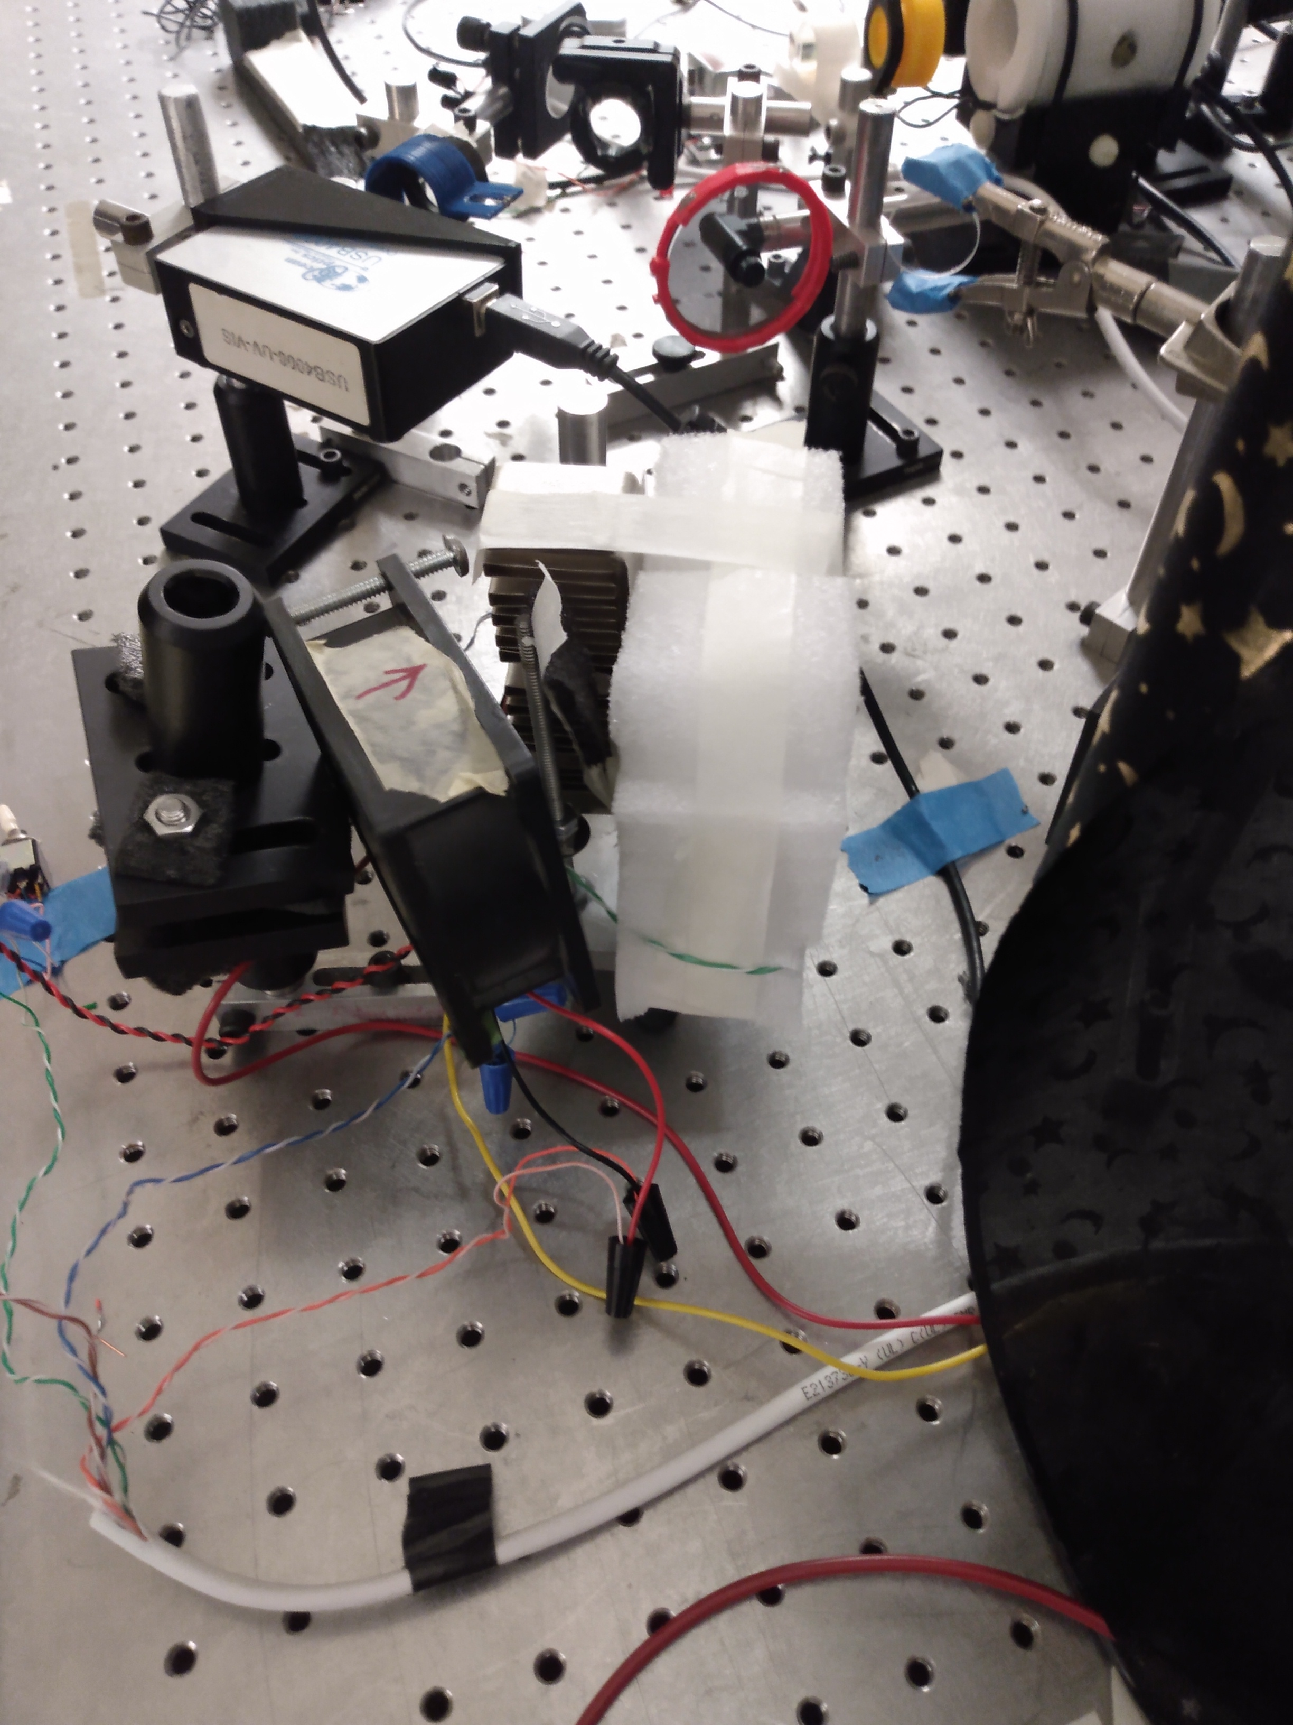
776nm laser
Fan, to carry heat away
from the TEC cooler

Slide 12
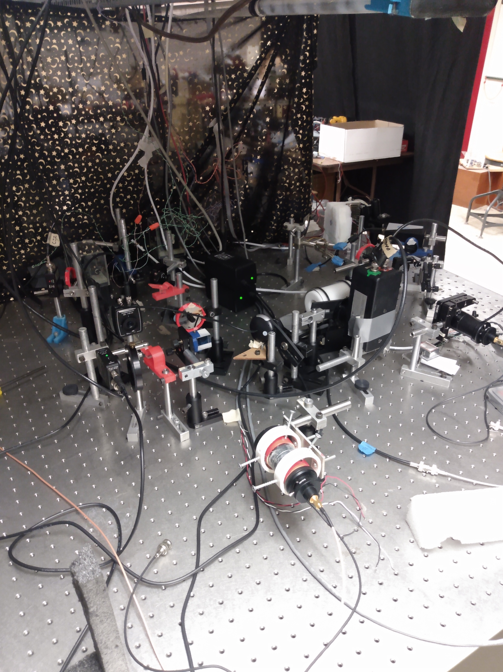
All together

Slide 13
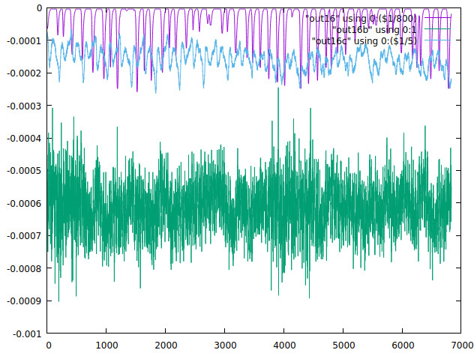
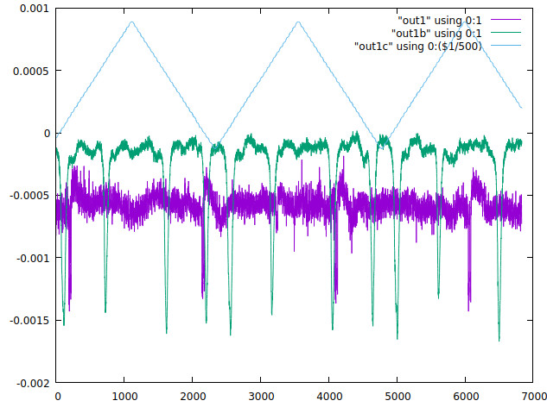
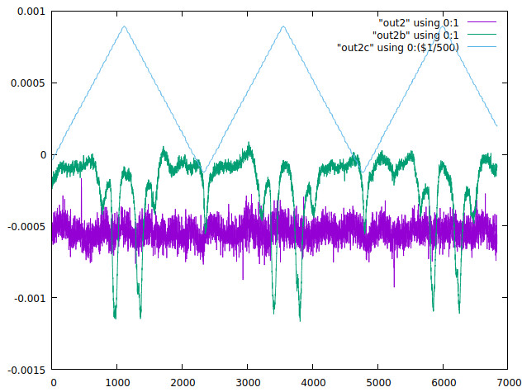

Slide 14
Future and Goals
• Improve signal strength through better beam alignment and polarization control
• Repair and integrate the wavemeter to monitor 776 nm wavelength accurately
• Optimize data collection for clear resonance detection
Virtual State

Slide 15
References
Beard, River, et al. Two-photon rubidium clock detecting 776 nm fluorescence. Optics Express, vol. 32, no. 4, 2024, pp. 6376–6387. Optical Society of America, https://pubmed.ncbi.nlm.nih.gov/38439422.
Ma, Weiyong, et al. Experimental study on transit time broadening in rubidium 5S–5D transition. Applied Optics, vol. 61, no. 16, 2022, pp. 4719–4724. Optical Society of America, https://opg.optica.org/abstract.cfm?uri=ao-61-16-4719.

Slide 16
Thank You
Questions?

