Slide 1

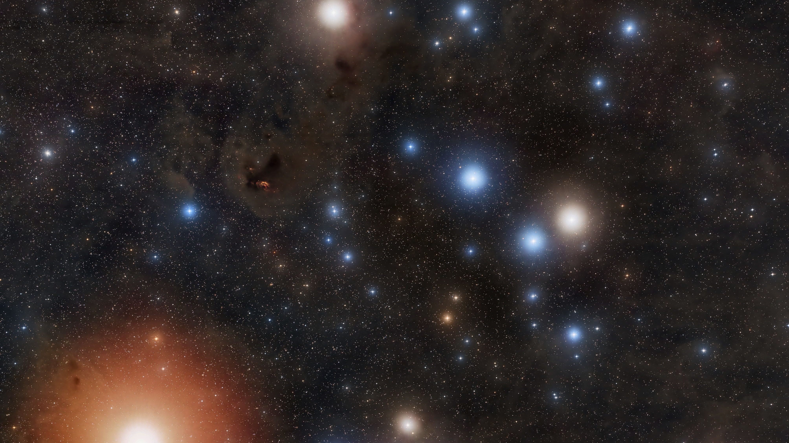

Pinpointing the age
of the Hyades Cluster
Zach Lao
Advisor: Dr. Jeremy Jones
NSF: 2050829
RAY BLAIS
Notes:
YSU LOGO and GSU LOGO

Slide 2
1
Mission
What?
Why?
How?
Create a more accurate age estimate of the Hyades Cluster.
Further understand stellar evolution models and calibrate the cosmic distance scale
Using the 4 brightest stars in the cluster.
The CHARA Array Interferometer
The Hyades Cluster is a group stars with similar ages and composition that are close to observe
Compare with Boyajian '09
RAY BLAIS
Notes:
WHY: CURRENT AGE ESTIMATE IS A LARGE RANGE!
Hyades is first rung on the cosmic ladder
Mention classic data
Similar in age and internal composition, the differences are mass, similar is important but not the main thing

Slide 3
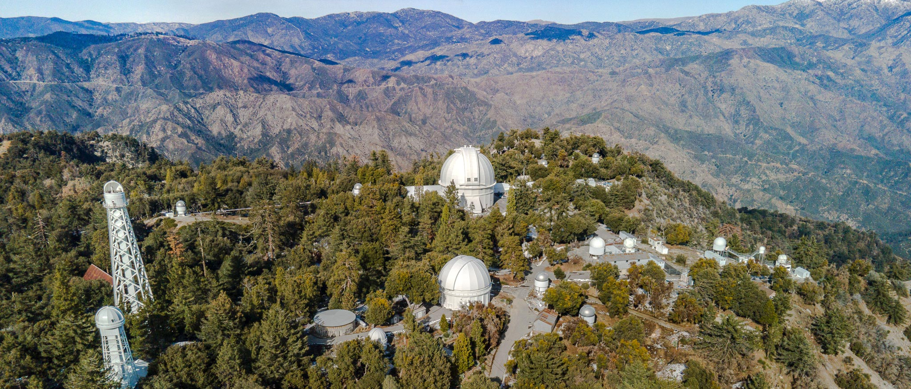
The CHARA (Center for High Angular Resolution Astronomy) Array
2
2
Interferometry
Our 4 Giants
Six 1-meter telescopes, placed various distances that combine the light from each telescope though vacuum tubes to the central Beam Synthesis Facility.
γ Tau, δ Tau, ε Tau, θ Tau (G9)
Giants show similarities to the greater group (Age & Composition)
CHARA observations from December 12-13, 2023
Beam paths are matched to an accuracy of less than a micron.
Largest baseline: 330m
Super high resolution!
Notes:
iNfered, ½ miliarcsec, compare distances!, just near inferred and visible.

Slide 4

3
Angular Diameters

Slide 5

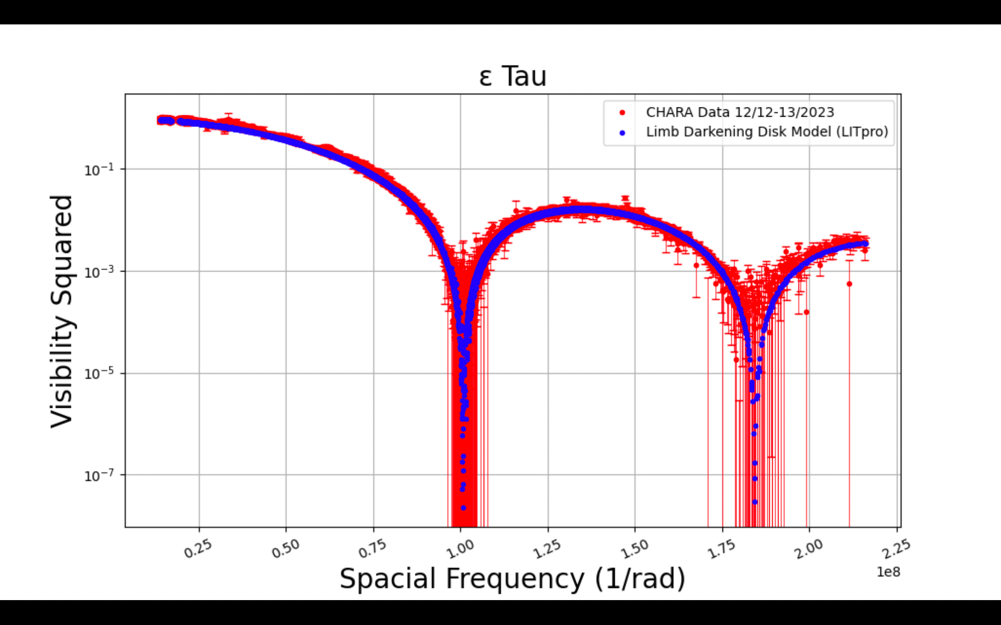
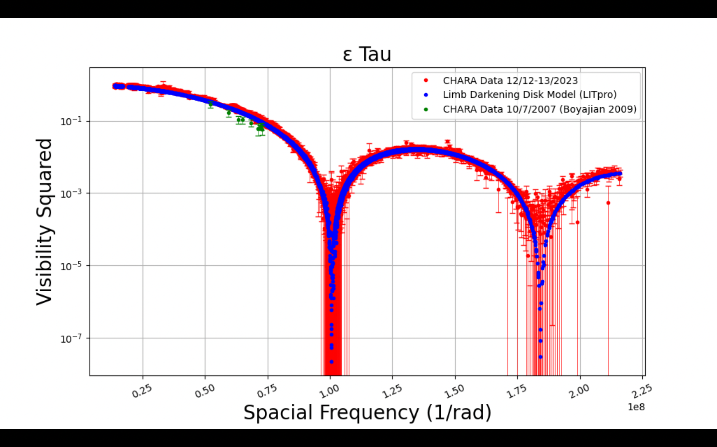
4
LITpro – Angular Diameters
This work:
θ: 2.53 ± 0.001 mas
𝜒²: 1.38
Boyajian work:
θ: 2.66 ± 0.03 mas
Notes:
Mention the model early on (Limb darken disk model, power function)
Elaborate on special freq seen as BASELINE/WAVELEGTH
Visibility also shows how the light is distributed over the source
The uncertainty is made from each individual data point (underestimated)
Visibility^2: a measure of the interference of the light between 2 telescopes, and a sample of the foria trannnsform of the source, gives info about the star at a given wavelength and baselines.
BASELINE/WAVELEGTH
Bandwidth smearing
, Visibility^2: a measure of the interference of the light between 2 telescopes, and a sample of the foria trannnsform, gives info about the star at a given wavelength and baselines.
Gives information about the size

Slide 6
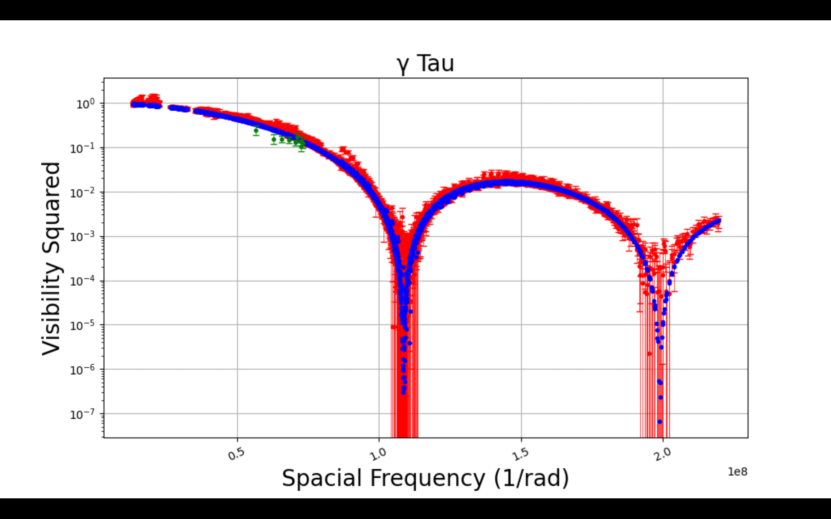
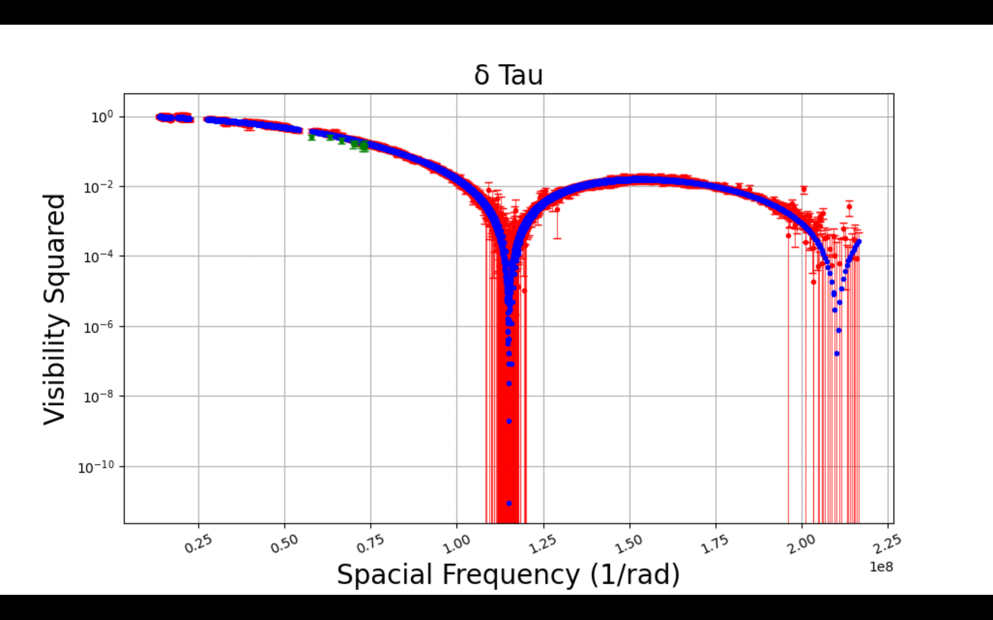
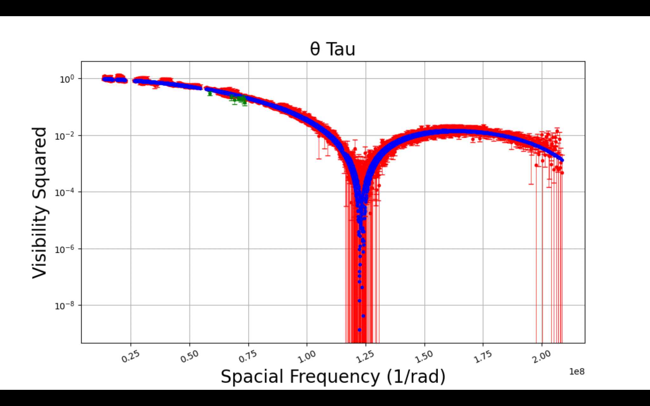
5
LITpro – Angular Diameters
My work:
γ Tau: 2.33 ± 0.001 mas
δ Tau: 2.22 ± 0.001 mas
ε Tau: 2.53 ± 0.001 mas
θ Tau: 2.12 ± 0.005 mas
Boyajian work:
γ Tau: 2.45 ± 0.03 mas
δ Tau: 2.35 ± 0.04 mas
ε Tau: 2.66 ± 0.03 mas
θ Tau: 2.25 ± 0.04 mas
Notes:
Mention the model early onn (Limb darken disk model)
Elaborate on special freq seen as baseline/wavelength
Banndwith smearing
, Visibility^2: a measure of the interference of the light between 2 telescopes, and a sample of the foria trannnsform, gives info about the star at a given wavelength and baselines.
Gives information about the size

Slide 7
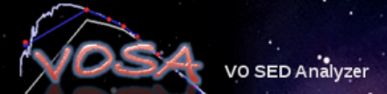
6
Bolometric Flux
Angular Diameters
Notes:
Virtual Observatory (SED) Analyzer (Spectal energy distribution)

Slide 8
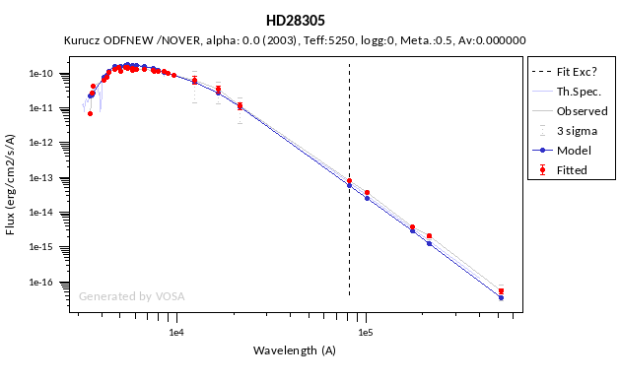
7
VOSA – Bolometric Flux
ε Tau
Flux_{BOL}: 1.24 x 10⁻⁶ ± 3.27 x 10⁻⁸ erg/cm²/s
Notes:
How much energy(flux) over all wavelengths

Slide 9

8
ε Tau Parallax: 22.4 ± 0.2 mas
Bolometric Flux
Angular Diameters
Parallax

Slide 10
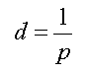
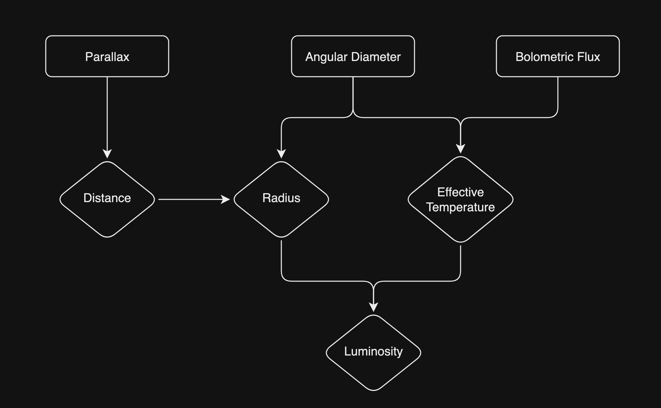
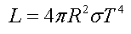
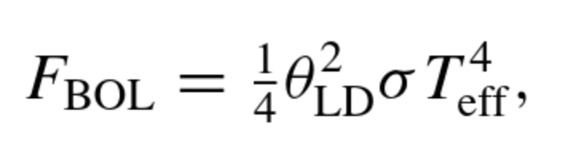
9

Slide 11
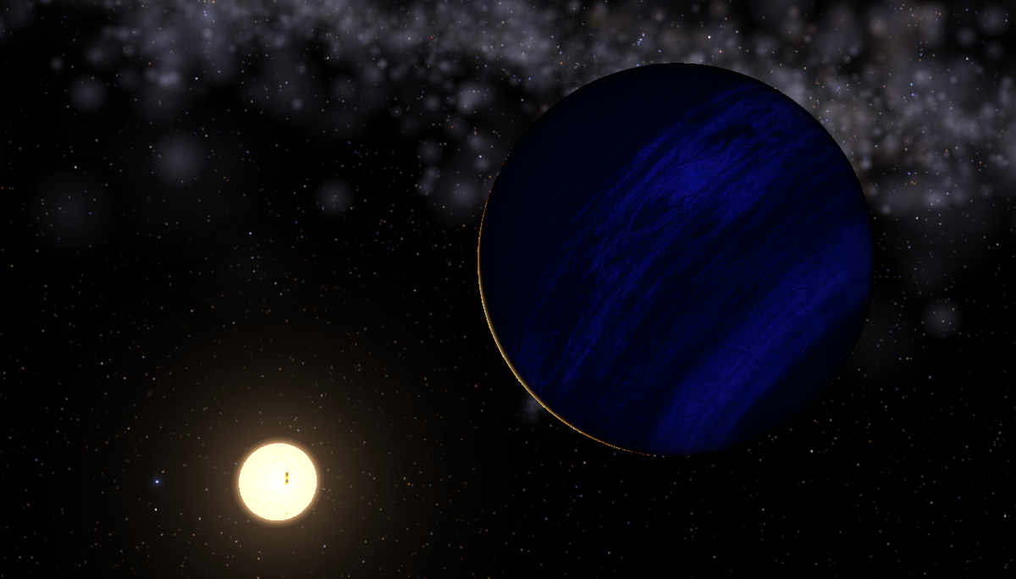
Effective Temperature: 4911 ± 29 K
ε Tau
10
Distance: 44.7 ± 0.6 Parsecs
Radius: 12.1 ± 0.2 R☉
Luminosity: 77.4 ± 3.6 L☉
γ Tau
Distance: 46.2 ± 0.4 Parsecs
Radius: 11.6 ± 0.1 R☉
Effective Temperature: 5018 ± 27 K
Luminosity: 76.6 ± 3.9 L☉
δ Tau
Distance: 49.2 ± 0.6 Parsecs
Radius: 11.8 ± 0.1 R☉
Effective Temperature: 5017 ± 27 K
Luminosity: 78.9 ± 3.5 L☉
θ Tau
Distance: 47.3 ± 0.6 Parsecs
Radius: 10.8 ± 0.2 R☉
Effective Temperature: 5057 ± 29 K
Luminosity: 68.6 ± 3.6 L☉
Notes:
Artist representation of ε Tau star and exoplanet

Slide 12

11
Bolometric Flux
Angular Diameters
Age Estimation
Parallax
Notes:
MESA Isochrones & Stellar Tracks
(MESA) Modules for Experiments in Stellar Astrophysics

Slide 13
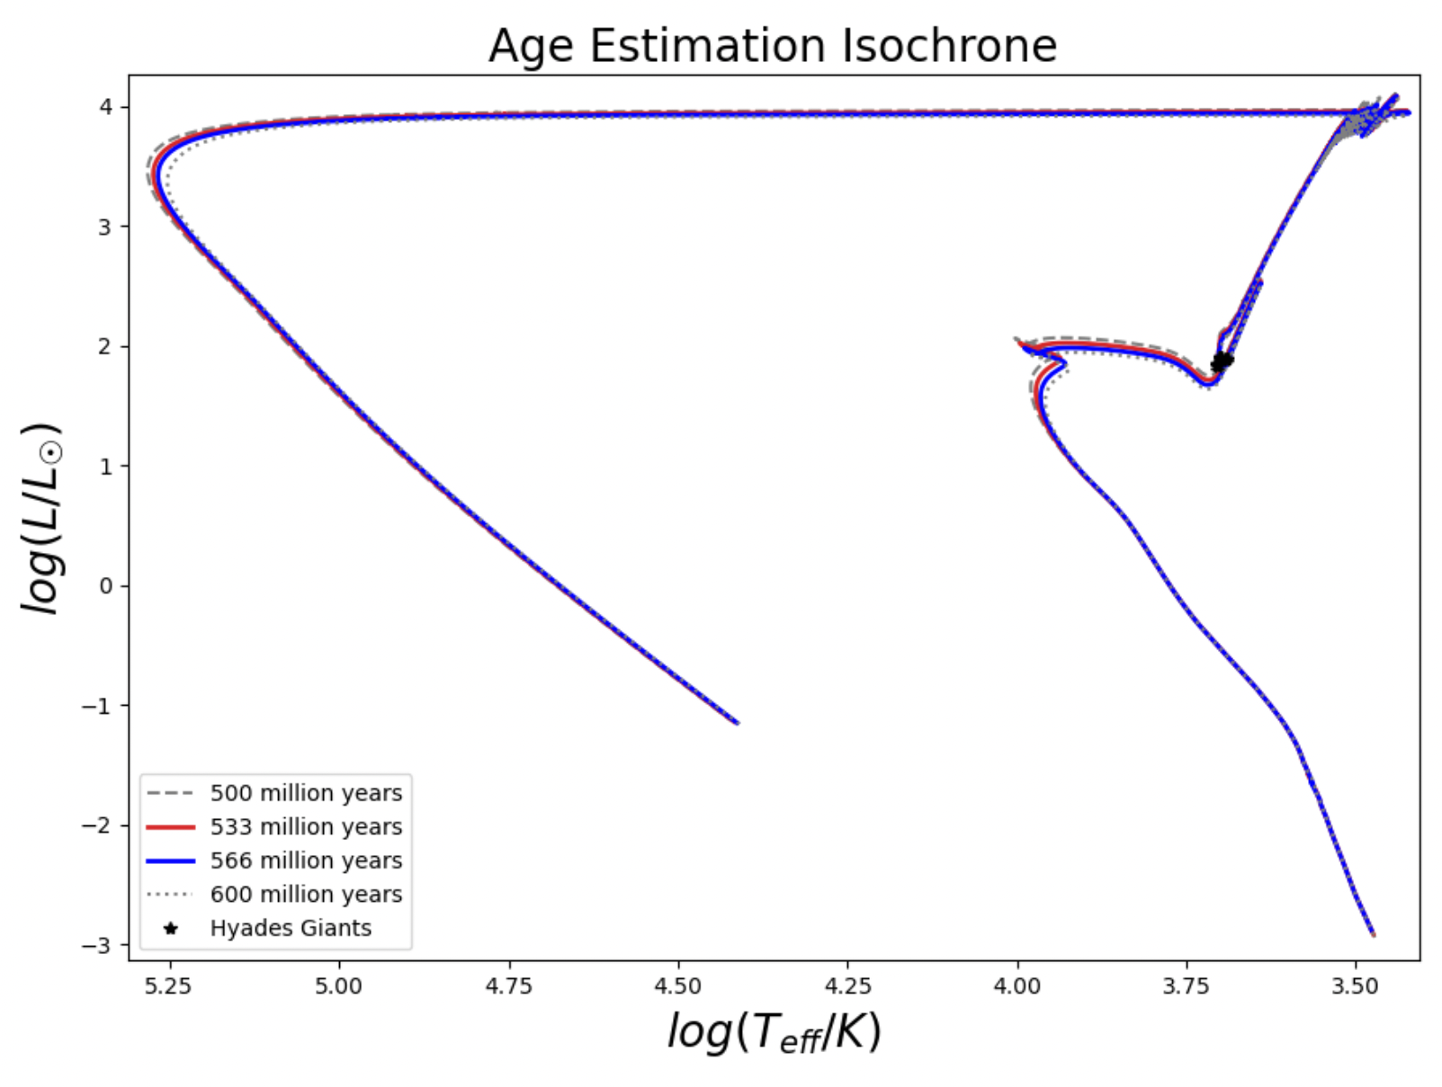
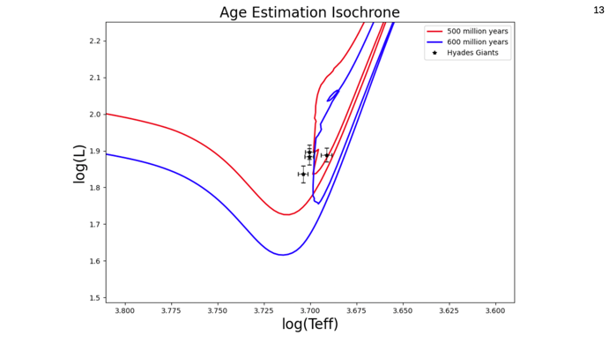
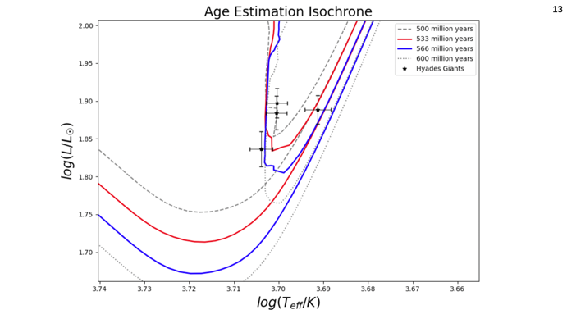
12
MIST – Age Estimation
Notes:
In the end were looking at the age of the cluster so pinpointing these stars is great instead of aging every last star

Slide 14
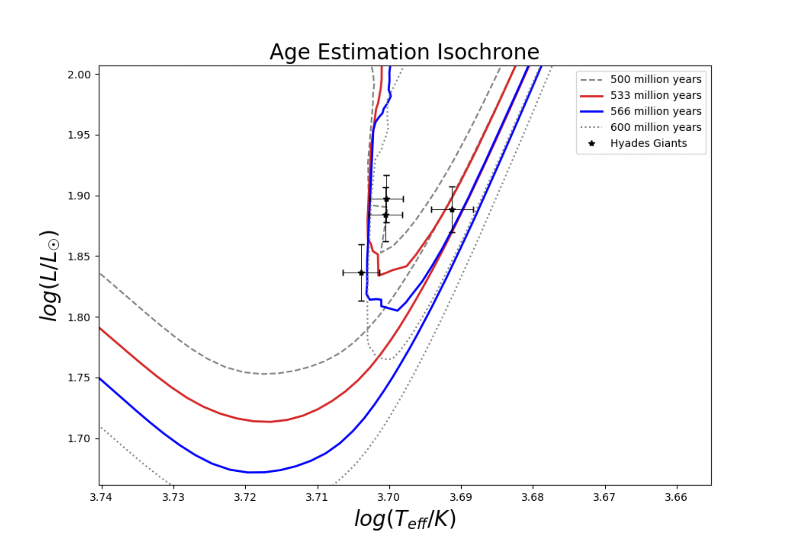
13
Age of Giants: ~550 million years old
Age of Hyades Cluster: 500-600 million years old
Notes:
Evolution models (refinement)

Slide 15
Summary
14
Find Angular Diameter, Bolometric Flux, Parallax
Calculate stellar properties (Temp, Luminosity)
Estimate age with other models
Use CHARA data to study stellar binary or exoplanet

