Slide 1
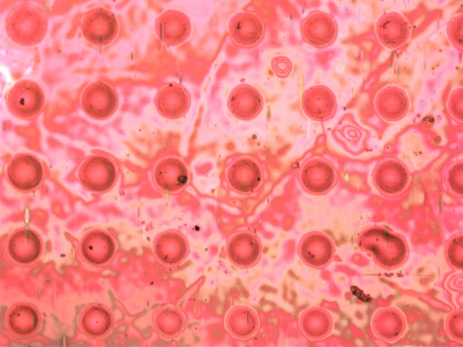
The Very Small Array
The effects of nanostructure on the focal properties of microlenses
Bryson Stemock
In Collaboration with Zhihan Li, Advised by Dr. Michael Crescimanno

Slide 2
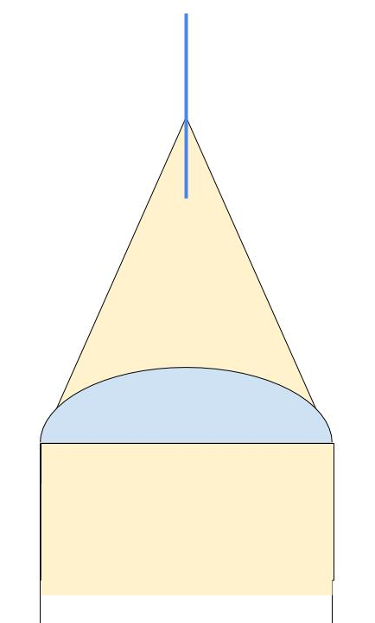
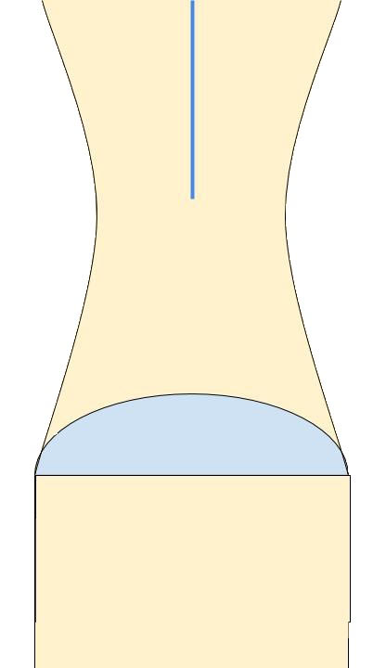
Basics

Slide 3
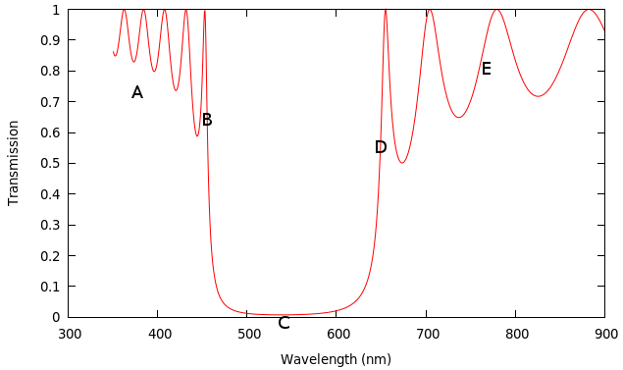
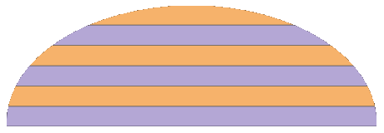
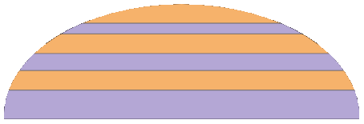
Theory
Bilayering
Layer Chirping

Slide 4
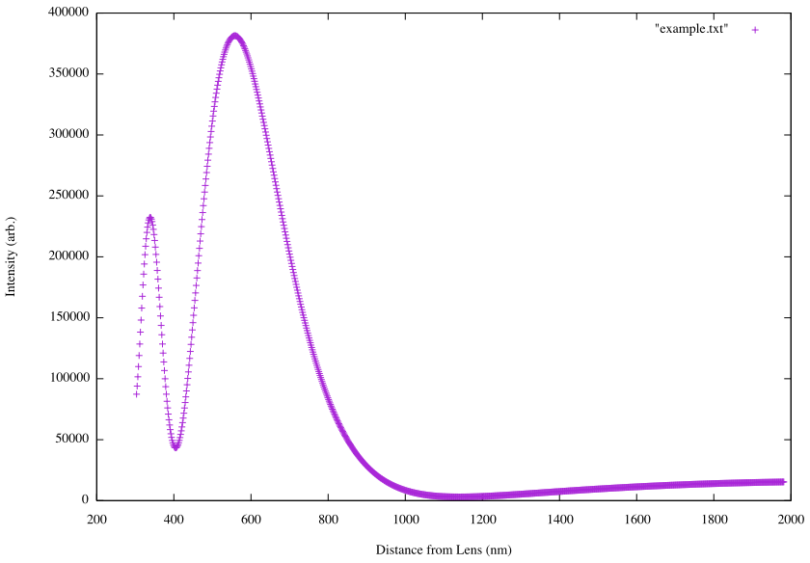

Slide 5
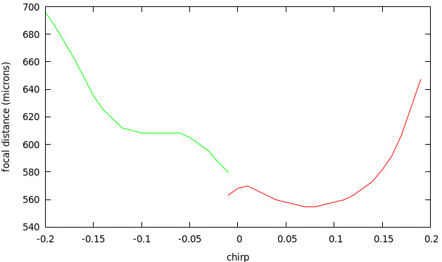
Theory- 456 nm
???

Slide 6
Experiment- Goals
Create microlenses comparable to those modeled in the code
Examine the effect of layer chirping on focal length
Replicate focal and chromatic results from prior work

Slide 7
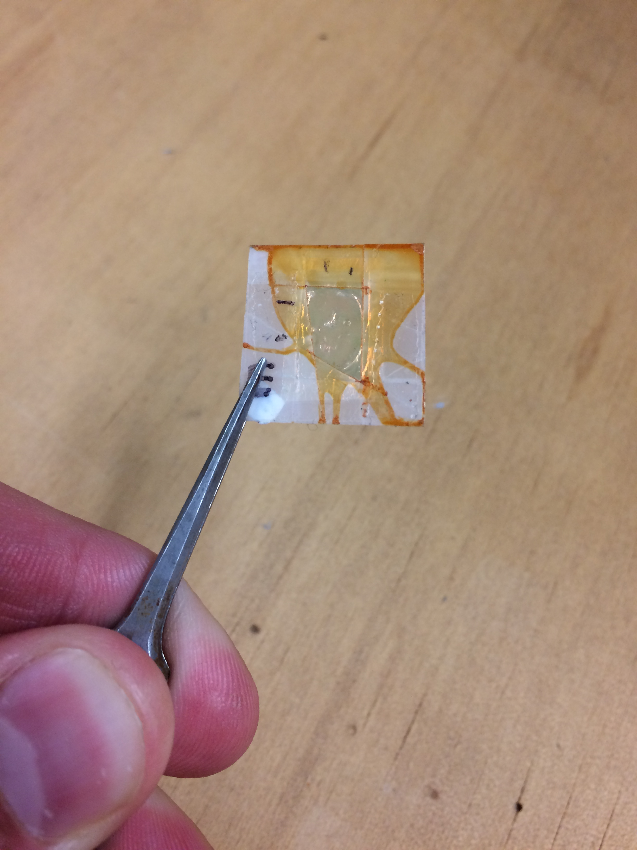
Experiment
Previously etched bilayered microlenses from Crescimanno and Oder et al. 2014 made of THV and PS (tetrafluoroethylene vinyl and polystyrene)
Monolithic commercial microlenses made of fused silica (quartz)

Slide 9
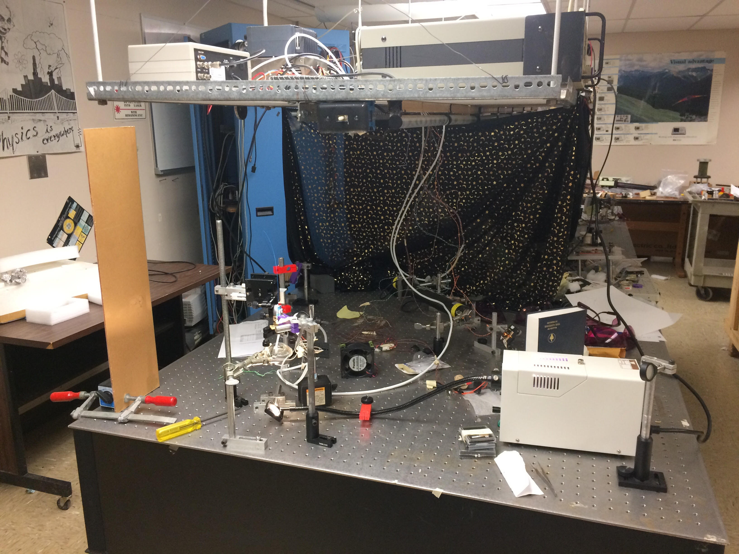

Slide 10
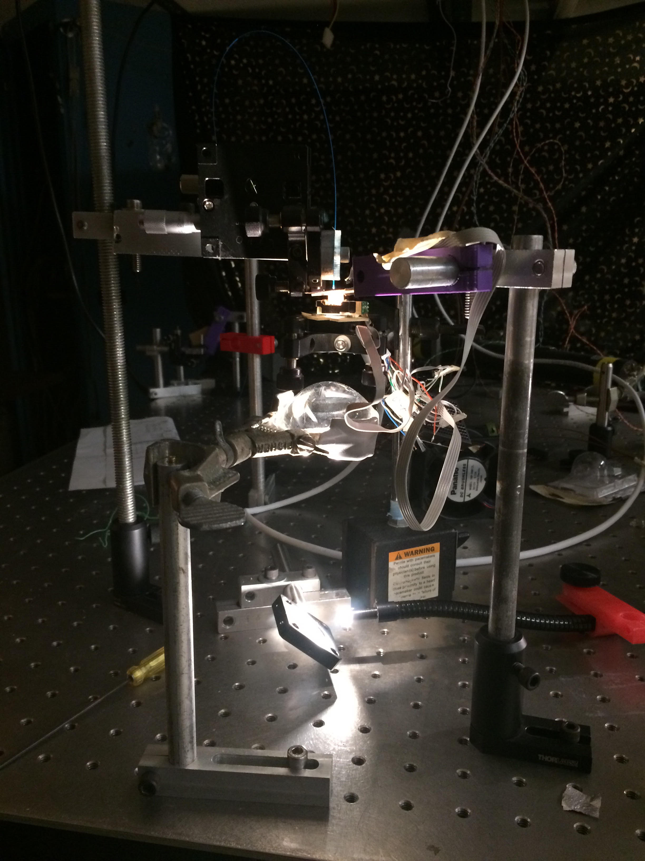
Experiment- Setup
Light Source
Mirror
Converging Lens
Kinetic Stage and Sensor
Microlens Array
Fiber Optic
6
5
4
3
1
2

Slide 11
6
5
4
3
2
1

Slide 12
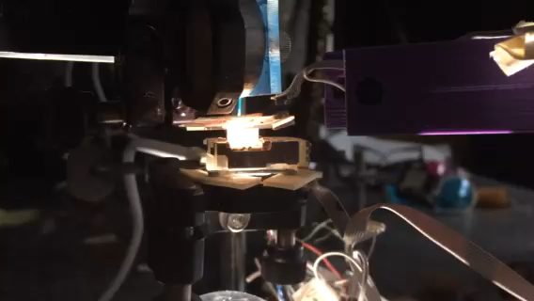

Slide 13
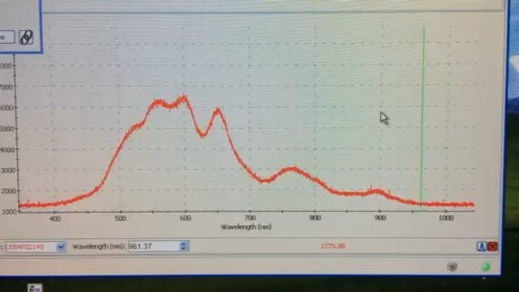

Slide 14
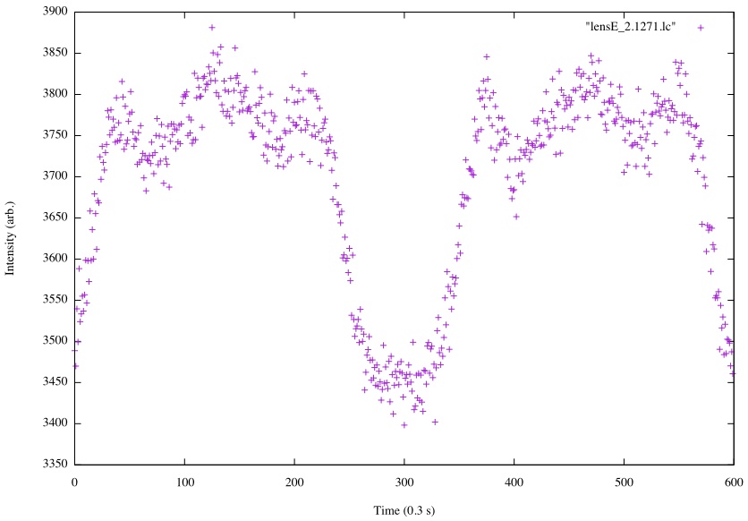

Slide 15
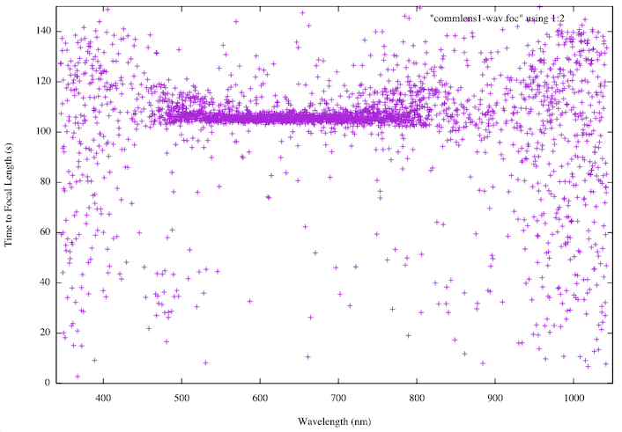

Slide 16
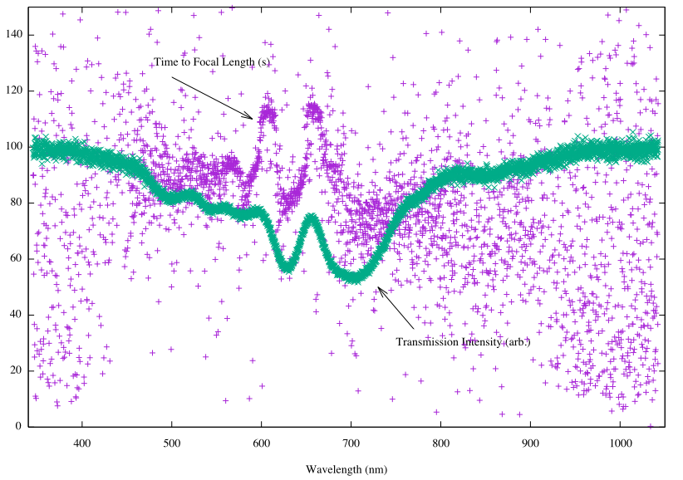

Slide 17
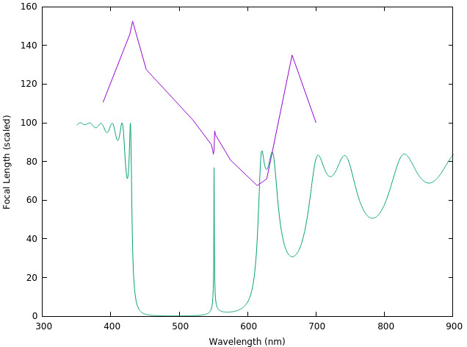

Slide 18
Results
Simulated effects due to layer chirping
Found an expected chromatic effect on focal length due to the bilayered material
Found an unexpected chromatic focal length effect, possibly due to a defect in the lenses

Slide 19
References
Crescimanno, M., Oder, T., Andrews, J., et al. 2014, OSA
MLA150-5C 10 mm x 10 mm Unmounted Lens Array, 300-1100 nm, Chrome Mask, Pitch=150 µm, f=5.2 mm. (n.d.). Retrieved from https://www.thorlabs.de/thorproduct.cfm?partnumber=mla150-5c

