Slide 1

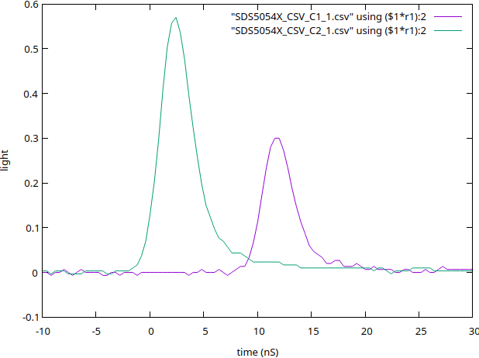
Poster template
Title of the lab
By name1, name2...MUST PUT BOTH NAMES HERE
Introduction
In this lab we measured the speed of light using
by comparing the delay of pulse as it propagates
through air and water.
Dont write here
Experiment/Data
Don’t write here
Experimental Schematic
LASER
Detector 1
Detector 2
Don’t write here
Propagation time delay
Our data shows there was a 11.3nS delay
between the two pulses.
Conclusions
Since we measured a distance of 3.25+/-0.05
meters in the distance difference between the
sensors, this gave for the speed of light a
measurement of
V = d/t = 3.25/11.3 = 2.87e8 +/- 0.04 m/s
Which is within 4 sigma of the accepted value of
the speed of light in the vacuum.
Don’t write here either !
Notes:
1/7/26
<number>
<number>
1/7/26
<number>
1/7/26
<number>
1/7/26
<number>
1/7/26
<number>
1/7/26
<number>
1/7/26
<number>
1/7/26
<number>
1/7/26
<number>
<number>
1/7/26
<number>
<number>
<number>
<number>
<number>

